Slide 1




LENDI INSTITUTE OF ENGINEERING AND TECHNOLOGY
(Autonomous)
Approved by AICTE and Permanently affiliated to JNTU Gurajada-Vizianagaram.
ECE,EEE,CSE&MECH
DEPARTMENT OF COMPUTER SCIENCE AND ENGINEERING
NAME OF THE SUBJECT :Distributed Systems
NAME OF THE TOPIC :Interprocess Communication
PRESENTED BY :
Mr. Satish Dekka
Associate Professor

Slide 2
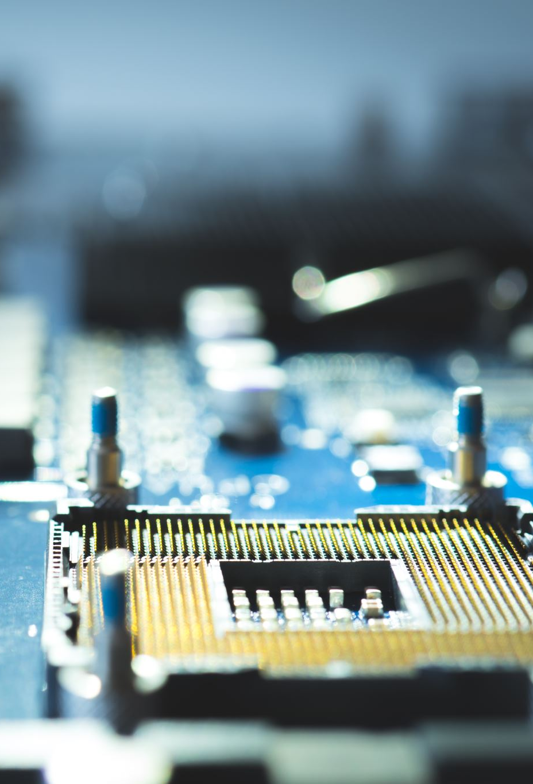
Contents:
Introduction
The API for the Internet Protocols
The Characteristics of Interprocess communication
Sockets
UDP Datagram Communication
TCP Stream Communication
External Data Representation and Marshalling
Client Server Communication
Group Communication- IP Multicast- an implementation of group communication
Reliability and Ordering of Multicast.

Slide 3
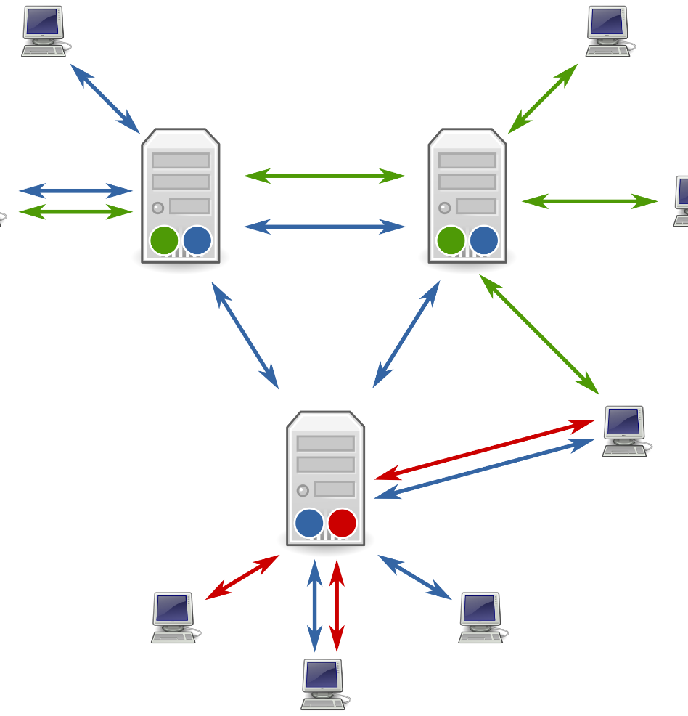
Introduction
Interprocess Communication is a process of exchanging the data between two or more independent process in a distributed environment is called as Interprocess communication. Interprocess communication on the internet provides both Datagram and stream communication.
Examples Of Interprocess Communication:
N number of applications can communicate with the X server through network protocols.
Servers like Apache spawn child processes to handle requests.
Pipes are a form of IPC: grep foo file | sort
It has two functions:
Synchronization:
Exchange of data is done synchronously which means it has a single clock pulse.
Message Passing:
When processes wish to exchange information. Message passing takes several forms such as: pipes, FIFO, Shared Memory, and Message Queues.

Slide 4

Characteristics of Inter-process Communication:
There are mainly five characteristics of inter-process communication in a distributed environment/system.
Synchronous System Calls:
In the synchronous system calls both sender and receiver use blocking system calls to transmit the data which means the sender will wait until the acknowledgment is received from the receiver and receiver waits until the message arrives.
Asynchronous System Calls:
In the asynchronous system calls, both sender and receiver use non-blocking system calls to transmit the data which means the sender doesn’t wait from the receiver acknowledgment.
Message Destination:
A local port is a message destination within a computer, specified as an integer. Aport has exactly one receiver but many senders. Processes may use multiple ports from which to receive messages. Any process that knows the number of a port can send the message to it.
Reliability:
It is defined as validity and integrity.
Integrity:
Messages must arrive without corruption and duplication to the destination.
Validity:
Point to point message services are defined as reliable, If the messages are guaranteed to be delivered without being lost is called validity.
Ordering:
It is the process of delivering messages to the receiver in a particular order. Some applications require messages to be delivered in the sender order i.e the order in which they were transmitted by the sender.

Slide 5
Introduction
The java API for interprocess communication in the internet provides both datagram and stream communication. The two communication patterns that are most commonly used in distributed programs: Client-Server communication The request and reply messages provide the basis for remote method invocation (RMI) or remote procedure call (RPC). Group communication The same message is sent to several processes.
Couloris,Dollimore and Kindberg Distributed Systems: Concepts & Design Edn. 4 , Pearson Education 2005

Slide 6
Introduction
Remote Method Invocation (RMI) It allows an object to invoke a method in an object in a remote process. E.g. CORBA and Java RMI Remote Procedure Call (RPC) It allows a client to call a procedure in a remote server.
Couloris,Dollimore and Kindberg Distributed Systems: Concepts & Design Edn. 4 , Pearson Education 2005

Slide 7
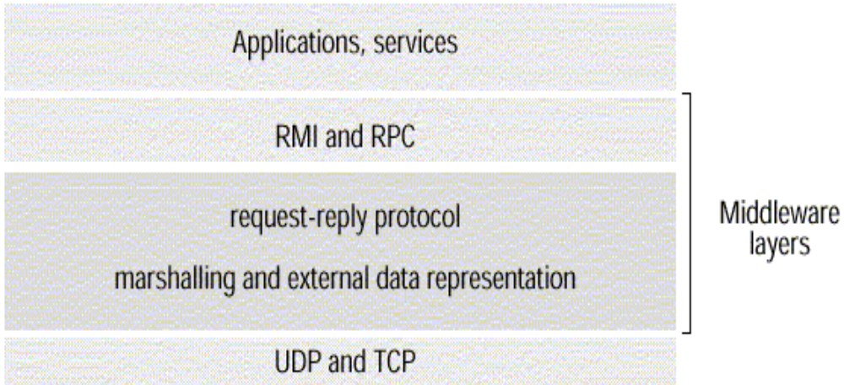
Introduction
This chapter is concerned with middleware.
Figure 1. Middleware layers
Couloris,Dollimore and Kindberg Distributed Systems: Concepts & Design Edn. 4 , Pearson Education 2005

Slide 8
Introduction
The application program interface (API) to UDP provides a message passing abstraction. Message passing is the simplest form of interprocess communication. API enables a sending process to transmit a single message to a receiving process. The independent packets containing theses messages are called datagrams. In the Java and UNIX APIs, the sender specifies the destination using a socket.
Couloris,Dollimore and Kindberg Distributed Systems: Concepts & Design Edn. 4 , Pearson Education 2005

Slide 9
Introduction
Socket is an indirect reference to a particular port used by the destination process at a destination computer. The application program interface (API) to TCP provides the abstraction of a two-way stream between pairs of processes. The information communicated consists of a stream of data items with no message boundaries.
Couloris,Dollimore and Kindberg Distributed Systems: Concepts & Design Edn. 4 , Pearson Education 2005

Slide 10
Introduction
The application program interface (API) to UDP provides a message passing abstraction. Message passing is the simplest form of interprocess communication. API enables a sending process to transmit a single message to a receiving process. The independent packets containing theses messages are called datagrams. In the Java and UNIX APIs, the sender specifies the destination using a socket.
Couloris,Dollimore and Kindberg Distributed Systems: Concepts & Design Edn. 4 , Pearson Education 2005

Slide 11
Introduction
Socket is an indirect reference to a particular port used by the destination process at a destination computer. The application program interface (API) to TCP provides the abstraction of a two-way stream between pairs of processes. The information communicated consists of a stream of data items with no message boundaries.
Couloris,Dollimore and Kindberg Distributed Systems: Concepts & Design Edn. 4 , Pearson Education 2005

Slide 12
Introduction
Request-reply protocols are designed to support client-server communication in the form of either RMI or RPC. Group multicast protocols are designed to support group communication. Group multicast is a form of interprocess communication in which one process in a group of processes transmits the same message to all members of the group.
Couloris,Dollimore and Kindberg Distributed Systems: Concepts & Design Edn. 4 , Pearson Education 2005

Slide 13
The API for the Internet Protocols
SOCKET UDP DATAGRAM COMMUNICATION TCP STREAM COMMUNICATION
Couloris,Dollimore and Kindberg Distributed Systems: Concepts & Design Edn. 4 , Pearson Education 2005

Slide 14
Sockets
Internet IPC mechanism of Unix and other operating systems (BSD Unix, Solaris, Linux, Windows NT, Macintosh OS) Processes in the above OS can send and receive messages via a socket. Sockets need to be bound to a port number and an internet address in order to send and receive messages. Each socket has a transport protocol (TCP or UDP). Messages sent to some internet address and port number can only be received by a process using a socket that is bound to this address and port number. Processes cannot share ports (exception: TCP multicast).
Couloris,Dollimore and Kindberg Distributed Systems: Concepts & Design Edn. 4 , Pearson Education 2005

Slide 15
Sockets
Both forms of communication, UDP and TCP, use the socket abstraction, which provides and endpoint for communication between processes. Interprocess communication consists of transmitting a message between a socket in one process and a socket in another process.
Couloris,Dollimore and Kindberg Distributed Systems: Concepts & Design Edn. 4 , Pearson Education 2005

Slide 16
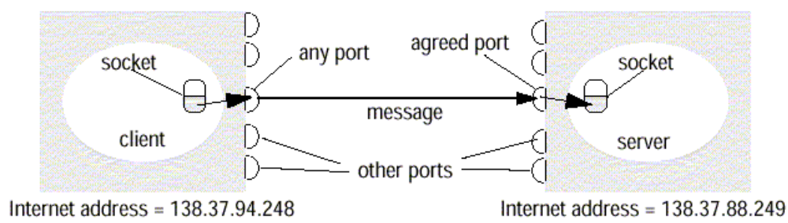
Sockets
Pipes are a form of IPC
Figure 2. Sockets and ports
Couloris,Dollimore and Kindberg Distributed Systems: Concepts & Design Edn. 4 , Pearson Education 2005

Slide 17
UDP Datagram Communication
UDP datagram properties No guarantee of order preservation Message loss and duplications are possible Necessary steps Creating a socket Binding a socket to a port and local Internet address A client binds to any free local port A server binds to a server port Receive method It returns Internet address and port of sender, plus message.
Couloris,Dollimore and Kindberg Distributed Systems: Concepts & Design Edn. 4 , Pearson Education 2005

Slide 18
UDP Datagram Communication
Issues related to datagram communications are: Message size IP allows for messages of up to 216 bytes. Most implementations restrict this to around 8k bytes. Any application requiring messages larger than the maximum must fragment. If arriving message is too big for array allocated to receive message content, truncation occurs. Blocking Send: non-blocking upon arrival, message is placed in a queue for the socket that is bound to the destination port. Receive: blocking Pre-emption by timeout possible If process wishes to continue while waiting for packet, use separate thread Timeout Receive from any
Couloris,Dollimore and Kindberg Distributed Systems: Concepts & Design Edn. 4 , Pearson Education 2005

Slide 19
UDP Datagram Communication
UDP datagrams suffer from following failures: Omission failure Messages may be dropped occasionally, Ordering
Couloris,Dollimore and Kindberg Distributed Systems: Concepts & Design Edn. 4 , Pearson Education 2005

Slide 20
Java API for UDP Datagrams
The Java API provides datagram communication by two classes: DatagramPacket It provides a constructor to make an array of bytes comprising: Message content Length of message Internet address Local port number It provides another similar constructor for receiving a message.
array of bytes containing message | length of message| Internet address | port number|
Couloris,Dollimore and Kindberg Distributed Systems: Concepts & Design Edn. 4 , Pearson Education 2005

Slide 21
Java API for UDP Datagrams
DatagramSocket This class supports sockets for sending and receiving UDP datagram. It provides a constructor with port number as argument. No-argument constructor is used to choose a free local port. DatagramSocket methods are: send and receive setSoTimeout Connect Example – The process creates a socket, sends a message to a server at port 6789 and waits to receive a reply.
Couloris,Dollimore and Kindberg Distributed Systems: Concepts & Design Edn. 4 , Pearson Education 2005

Slide 22
Java API for UDP Datagrams
Example – The process creates a socket, sends a message to a server at port 6789 and waits to receive a reply. (Figure 3)
Couloris,Dollimore and Kindberg Distributed Systems: Concepts & Design Edn. 4 , Pearson Education 2005

Slide 23
Java API for UDP Datagrams
import java.net.*; import java.io.*; public class UDPClient{ public static void main(String args[]){ // args give message contents and destination hostname try { DatagramSocket aSocket = new DatagramSocket(); // create socket byte [] m = args[0].getBytes(); InetAddress aHost = InetAddress.getByName(args[1]); // DNS lookup int serverPort = 6789; DatagramPacket request =new DatagramPacket(m, args[0].length(), aHost, serverPort); aSocket.send(request); //send nessage byte[] buffer = new byte[1000]; DatagramPacket reply = new DatagramPacket(buffer, buffer.length); aSocket.receive(reply); //wait for reply System.out.println("Reply: " + new String(reply.getData())); aSocket.close(); }catch (SocketException e){System.out.println("Socket: " + e.getMessage()); }catch (IOException e){System.out.println("IO: " + e.getMessage());} } finally{if (aSocket !=null)aSocket.close()} } }
Figure 3. UDP client sends a message to the server and gets a reply
Couloris,Dollimore and Kindberg Distributed Systems: Concepts & Design Edn. 4 , Pearson Education 2005

Slide 24
Java API for UDP Datagrams
Example – The process creates a socket, bound to its server port 6789 and waits to receive a request message from a client. (Figure 4)
Couloris,Dollimore and Kindberg Distributed Systems: Concepts & Design Edn. 4 , Pearson Education 2005

Slide 25
Java API for UDP datagrams
import java.net.*; import java.io.*; public class UDPServer{ public static void main(String args[]){ DatagramSocket aSocket = null; try { aSocket = new DatagramSocket(6789); byte []buffer = new byte[1000]; While(true){ DatagramPacket request =new DatagramPacket(buffer, buffer.length); aSocket.receive(request); DatagramPacket reply = new DatagramPacket(request.getData(); request.getLength(),request.getAddress(), request.getPort(); aSocket.send(reply); } }catch (SocketException e){System.out.println("Socket: " + e.getMessage()); }catch (IOException e){System.out.println("IO: " + e.getMessage());} }finally{if (aSocket !=null)aSocket.close()} } }
Figure 4. UDP server repeatedly receives a request and sends it back to the client
Couloris,Dollimore and Kindberg Distributed Systems: Concepts & Design Edn. 4 , Pearson Education 2005

Slide 26
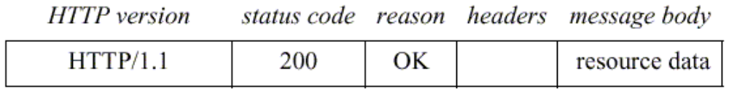
Client-Server Communication
A reply message specifies The protocol version A status code Reason Some headers An optional message body
Figure 17. HTTP reply message
Couloris,Dollimore and Kindberg Distributed Systems: Concepts & Design Edn. 4 , Pearson Education 2005

Slide 27
Group Communication
The pairwise exchange of messages is not the best model for communication from one process to a group of other processes. A multicast operation is more appropriate. Multicast operation is an operation that sends a single message from one process to each of the members of a group of processes.
Couloris,Dollimore and Kindberg Distributed Systems: Concepts & Design Edn. 4 , Pearson Education 2005

Slide 28
Group Communication
The simplest way of multicasting, provides no guarantees about message delivery or ordering. Multicasting has the following characteristics: Fault tolerance based on replicated services A replicated service consists of a group of servers.
Couloris,Dollimore and Kindberg Distributed Systems: Concepts & Design Edn. 4 , Pearson Education 2005

Slide 29
Group Communication
Client requests are multicast to all the members of the group, each of which performs an identical operation. Finding the discovery servers in spontaneous networking Multicast messages can be used by servers and clients to locate available discovery services in order to register their interfaces or to look up the interfaces of other services in the distributed system.
Couloris,Dollimore and Kindberg Distributed Systems: Concepts & Design Edn. 4 , Pearson Education 2005

Slide 30
Group Communication
Better performance through replicated data Data are replicated to increase the performance of a service. Propagation of event notifications Multicast to a group may be used to notify processes when something happens.
Couloris,Dollimore and Kindberg Distributed Systems: Concepts & Design Edn. 4 , Pearson Education 2005

Slide 31
Group Communication
IP multicast IP multicast is built on top of the Internet protocol, IP. IP multicast allows the sender to transmit a single IP packet to a multicast group. A multicast group is specified by class D IP address for which first 4 bits are 1110 in IPv4.
Couloris,Dollimore and Kindberg Distributed Systems: Concepts & Design Edn. 4 , Pearson Education 2005

Slide 32
Group Communication
The membership of a multicast group is dynamic. A computer belongs to a multicast group if one or more processes have sockets that belong to the multicast group.
Couloris,Dollimore and Kindberg Distributed Systems: Concepts & Design Edn. 4 , Pearson Education 2005

Slide 33
Group Communication
The following details are specific to IPv4: Multicast IP routers IP packets can be multicast both on local network and on the wider Internet. Local multicast uses local network such as Ethernet. To limit the distance of propagation of a multicast datagram, the sender can specify the number of routers it is allowed to pass- called the time to live, or TTL for short.
Couloris,Dollimore and Kindberg Distributed Systems: Concepts & Design Edn. 4 , Pearson Education 2005

Slide 34
Group Communication
Multicast address allocation Multicast addressing may be permanent or temporary. Permanent groups exist even when there are no members. Multicast addressing by temporary groups must be created before use and cease to exit when all members have left. The session directory (sd) program can be used to start or join a multicast session. session directory provides a tool with an interactive interface that allows users to browse advertised multicast sessions and to advertise their own session, specifying the time and duration.
Couloris,Dollimore and Kindberg Distributed Systems: Concepts & Design Edn. 4 , Pearson Education 2005

Slide 35
Group Communication
Java API to IP multicast The Java API provides a datagram interface to IP multicast through the class MulticastSocket, which is a subset of DatagramSocket with the additional capability of being able to join multicast groups. The class MulticastSocket provides two alternative constructors , allowing socket to be creative to use either a specified local port, or any free local port. (Figure 18)
Couloris,Dollimore and Kindberg Distributed Systems: Concepts & Design Edn. 4 , Pearson Education 2005

Slide 36
Group Communication
import java.net.*; import java.io.*; public class MulticastPeer{ public static void main(String args[]){ // args give message contents and destination multicast group (e.g. "228.5.6.7") MulticastSocket s =null; try { InetAddress group = InetAddress.getByName(args[1]); s = new MulticastSocket(6789); s.joinGroup(group); byte [] m = args[0].getBytes(); DatagramPacket messageOut = new DatagramPacket(m, m.length, group, 6789); s.send(messageOut); byte[] buffer = new byte[1000]; for(int i=0; i< 3;i++) { // get messages from others in group DatagramPacket messageIn = new DatagramPacket(buffer, buffer.length); s.receive(messageIn); System.out.println("Received:" + new String(messageIn.getData())); } s.leaveGroup(group); }catch (SocketException e){System.out.println("Socket: " + e.getMessage()); }catch (IOException e){System.out.println("IO: " + e.getMessage()); }finally {if(s != null) s.close();} } }
Figure 18. Multicast peer joins a group and sends and receives datagrams
Couloris,Dollimore and Kindberg Distributed Systems: Concepts & Design Edn. 4 , Pearson Education 2005

Slide 37
Group Communication
A process can join a multicast group with a given multicast address by invoking the joinGroup method of its multicast socket. A process can leave a specified group by invoking the leaveGroup method of its multicast socket. The Java API allows the TTL to be set for a multicast socket by means of the setTimeToLive method. The default is 1, allowing the multicast to propagate only on the local network.
Couloris,Dollimore and Kindberg Distributed Systems: Concepts & Design Edn. 4 , Pearson Education 2005

Slide 38
External Data Representation
External Data Representation is an agreed standard for the representation of data structures and primitive values. Data representation problems are: Using agreed external representation, two conversions necessary Using sender’s or receiver’s format and convert at the other end
Couloris,Dollimore and Kindberg Distributed Systems: Concepts & Design Edn. 4 , Pearson Education 2005

Slide 39
External Data Representation
Marshalling Marshalling is the process of taking a collection of data items and assembling them into a form suitable for transmission in a message. Unmarshalling Unmarshalling is the process of disassembling a collection of data on arrival to produce an equivalent collection of data items at the destination.
Couloris,Dollimore and Kindberg Distributed Systems: Concepts & Design Edn. 4 , Pearson Education 2005

Slide 40
External Data Representation
Three approaches to external data representation and marshalling are: CORBA Java’s object serialization XML
Couloris,Dollimore and Kindberg Distributed Systems: Concepts & Design Edn. 4 , Pearson Education 2005

Slide 41
External Data Representation
Marshalling and unmarshalling activities is usually performed automatically by middleware layer. Marshalling is likely error-prone if carried out by hand.
Couloris,Dollimore and Kindberg Distributed Systems: Concepts & Design Edn. 4 , Pearson Education 2005

Slide 42
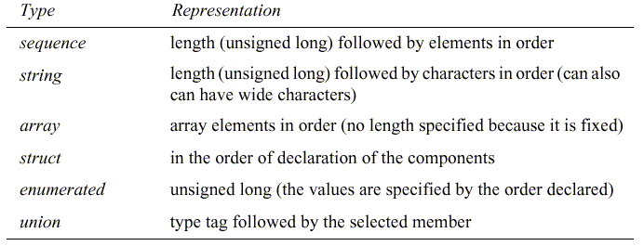
CORBA Common Data Representation (CDR)
Figure 8. CORBA CDR for constructed types
Couloris,Dollimore and Kindberg Distributed Systems: Concepts & Design Edn. 4 , Pearson Education 2005

Slide 43
CORBA Common Data Representation (CDR)
Constructed types: The primitive values that comprise each constructed type are added to a sequence of bytes in a particular order, as shown in Figure 8.
Couloris,Dollimore and Kindberg Distributed Systems: Concepts & Design Edn. 4 , Pearson Education 2005

Slide 44
CORBA Common Data Representation (CDR)
Constructed types: The primitive values that comprise each constructed type are added to a sequence of bytes in a particular order, as shown in Figure 8.
Couloris,Dollimore and Kindberg Distributed Systems: Concepts & Design Edn. 4 , Pearson Education 2005

Slide 45
TCP Stream Communication
The API to the TCP protocol provides the abstraction of a stream of bytes to be written to or read from. Characteristics of the stream abstraction: Message sizes Lost messages Flow control Message destinations Issues related to stream communication: Matching of data items Blocking Threads
Couloris,Dollimore and Kindberg Distributed Systems: Concepts & Design Edn. 4 , Pearson Education 2005

Slide 46
TCP Stream Communication
Use of TCP Many services that run over TCP connections, with reserved port number are: HTTP (Hypertext Transfer Protocol) FTP (File Transfer Protocol) Telnet SMTP (Simple Mail Transfer Protocol)
Couloris,Dollimore and Kindberg Distributed Systems: Concepts & Design Edn. 4 , Pearson Education 2005

